Slide 1
Introduction
Purpose
Provide an overview of Sipeed MAIX for RISC-V AI + IoT
Objectives:
Discuss key features of the Sipeed MAIX development boards
Provide an overview of how to use the Sipeed MAIX modules/dev. boards/kits
Explore main application types suited for the Sipeed MAIX modules/dev. boards
Discuss advantages of developing with the Sipeed MAIX modules/dev. boards
Content:
25 Pages
Notes:
Welcome to the Seeed Studio Sipeed MAIX product training module. The purpose of this presentation is to provide an overview of the Sipeed MAIX series products. The tutorial will give an in-depth look at key features and application scenarios. It will also introduce how to get started as well as discuss the benefits of developing with Sipeed MAIX.

Slide 2
Overview - MAIX
MAIX is Sipeed’ s purpose-built module designed to run AI at the edge(or so called AI + IoT).
It delivers high performance in a small physical and power footprint, enabling the deployment of high-accuracy AI at the edge, and the competitive price make it possible embed to any IoT devices.
Sipeed MAIX is quite like Google edge TPU, but it act as master controller, not an accelerator like edge TPU, so it is more low cost and low power than AP + Edge TPU solution.
Notes:
AI is pervasive today, from consumer to enterprise applications.
With the explosive growth of connected devices, combined with a demand for privacy/confidentiality, low latency and bandwidth constraints,
AI models trained in the cloud increasingly need to be run at the edge.
MAIX is Sipeed’ s purpose-built module designed to run AI at the edge

Slide 3
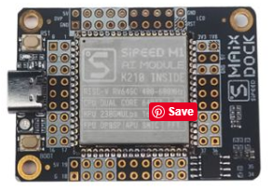
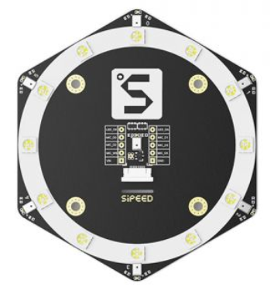
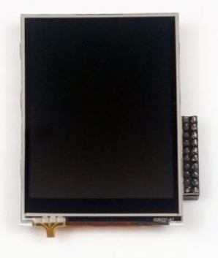
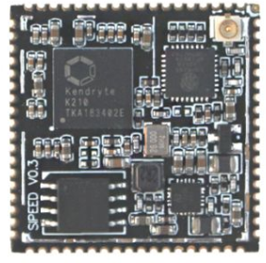
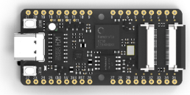
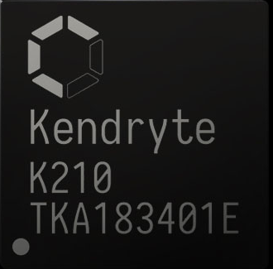
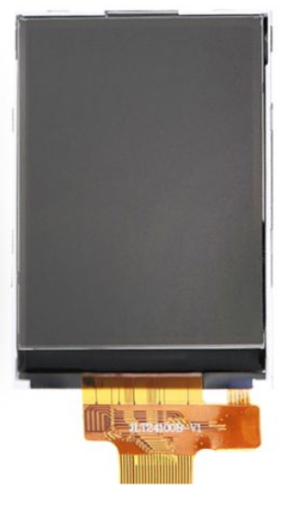
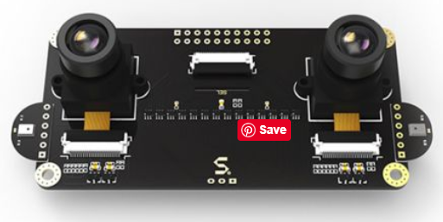
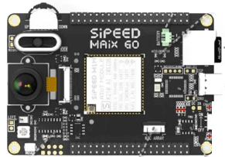
Overview - MAIX
Chip Modules Development Boards Peripherals .
M1 Dock
6+1 Mic Array
LCD for Go
MAIX-I
Module
K210
MAIX BiT
Binocular Camera module
I2S Mic
LCD for
Dock & Bit
Scenario Application Kits coming soon…
Notes:
There ‘re Modules, Development Boards/Kits, Peripherals and Scenario Application Kits in Sipeed MAIX Series.

Slide 4
Overview- MAIX
Based on K210 AI Chip,
MAIX-I module is a RISC-V 64 AI Module designed to run Edge AI.
M1 dock, MAIX BiT and MAIX Go are AI + IoT development boards based on MAIX-I module.
6+1 Mic array, I2S Mic, LCD and Binocular camera module are the peripherals for MAIX development boards.
MAIX isn't just a hardware solution, it combines custom hardware, open software, and state-of-the-art AI algorithms to provide high-quality, easy to deploy AI solutions for the edge.
Notes:
RISC-V 64 AI module, dev boards and substantial sensor module makes AI much easier. MAIX isn't just a hardware solution, it combines custom hardware, open software, and state-of-the-art AI algorithms to provide high-quality, easy to deploy AI solutions for the edge.

Slide 5
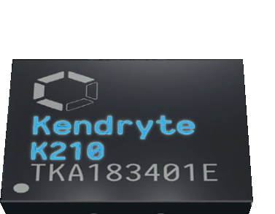
Overview - K210
The Kendryte K210 is a system-on
-chip(SoC) that integrates machine vision
and machine hearing.
Using TSMC's ultra-low-power 28nm advanced process with dual-core 64-bit processors for better power performance, stability and reliability.
The program strives for zero threshold development and can be deployed in the user's products in the shortest time, giving the product artificial intelligence.
The Kendryte K210 is located in the SoC of the AI ​​and IoT markets and is a very convenient MCU.
Notes:
The Kendryte K210 is a system-on-chip (SoC) that integrates machine vision and machine hearing. Using TSMC’s ultra-low-power 28-nm advanced process with dual-core 64-bit processors for better power efficiency, stability and reliability. The SoC strives for ”zero threshold” development and to be deployable in the user’s products in the shortest possible time, giving the product artificial intelligence.
Kendryte K210 is intended for the AI and IoT markets, but is also a high-performance MCU.

Slide 6
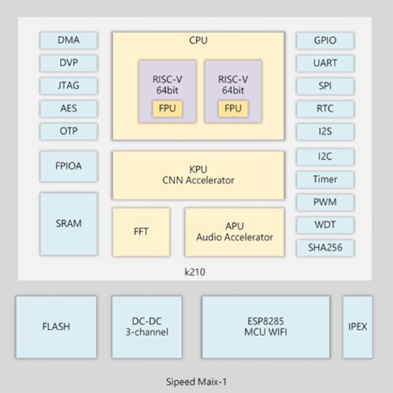
Overview - MAIX-I module
Inherit the advantage of K210‘s small footprint, MAIX-I module, integrate K210, 3-channel DC-DC power, 8MB Flash, Wi-Fi chip ESP8285(optional) into Square Inch Module.
All usable IO breaks out as 1.27mm(50mil) pins, and pin's voltage is selectable from 3.3V and 1.8V.
Notes:
The K210 includes two 64-bit RISC-V CPU cores, each with a built-in independent FPU. The primary functions of the K210 are machine vision and hearing, which includes the KPU for computing convolutional neural networks and an APU for pro-cessing microphone array inputs. The K210 features a Fast Fourier Transform (FFT) Accelerator for high performance complex FFT calculations. As a result, for most machine learning algorithms, the K210 has high-performance processing power.
The K210 embeds AES and SHA256 algorithm accelerators to provide users with basic security features.
The K210 features high-performance, low-power SRAM and powerful DMA for superior data throughput.
K210 has a wide range of peripheral units: DVP, JTAG, OTP, FPIOA, GPIO, UART, SPI, RTC, I2S, I2C, WDT, Timer and PWM, for a large number of application scenarios.

Slide 7
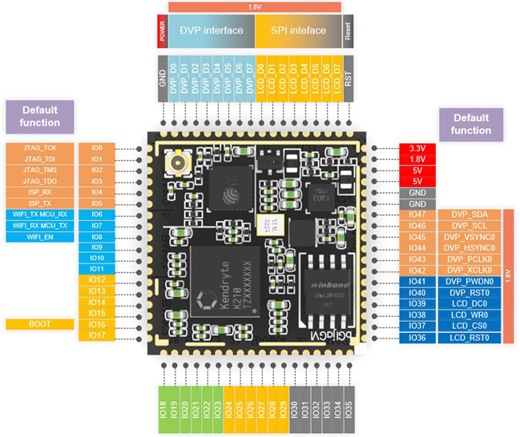
Overview MAIX-I module
Notes:
Inherit the advantage of K210‘s small footprint, MAIX-I module, integrate K210, 3-channel DC-DC power, 8MB Flash, Wi-Fi chip ESP8285(optional) into Square Inch Module.
All usable IO breaks out as 1.27mm(50mil) pins, and pin's voltage is selectable from 3.3V and 1.8V.

Slide 8
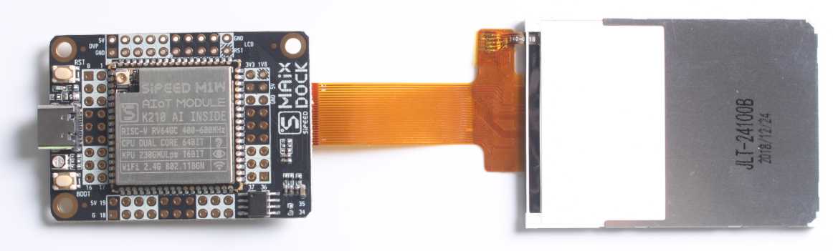
Overview - M1(w) dock
M1(w) dock is the 1st development board kit Sipeed released based on MAIX-I module (optional Wi-Fi)
It integrates USB2UART chip, auto download circuit, RGB LED, DVP Camera FPC connector (support small FPC camera and standard M12 camera), MCU LCD FPC connector (support 2.4-inch QVGA LCD), TF card slot.
The core voltage of M1w dock can be adjusted, from 0.8V~1.2V. And it can be overclocked to 800MHz.
Notes:
M1w dock is the 1st development board kit Sipeed released based on MAIX-I module Wi-Fi Version. M1 dock is w/o Wi-Fi version. 2.4-inch QVGA LCD and OV2640 camera are both included in the kit.

Slide 9
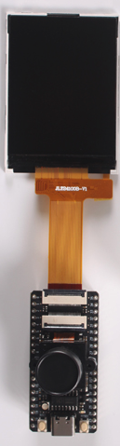
Overview - MAIX BiT
MAIX BiT(Kit) is a breadboard friendly version for DIYers to build prototypes with breadboard.
The board is twice of MAIX-I size, 1x2 inch, breadboard-friendly, and SMT- able.
It integrates USB2UART chip, auto download circuit, RGB LED, DVP Camera FPC connector (support small FPC camera and standard M12 camera), MCU LCD FPC connector (support 2.4-inch QVGA LCD), TF card slot.
Notes:
Sipeed provide MAIX Bit development board and development kit for it. The kit contains a 2.4-inch QVGA LCD and a OV2640 camera

Slide 10
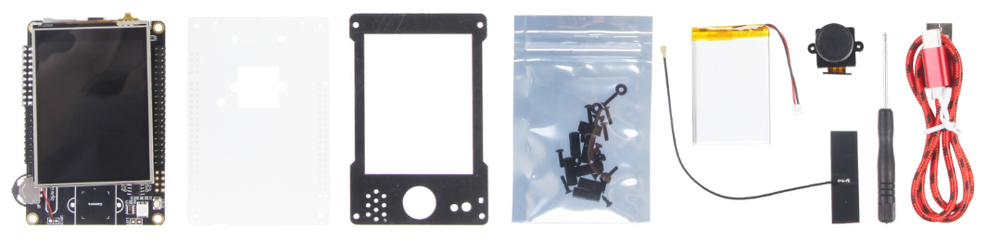
Overview - MAIX Go
MAIX Go is a full function dev. board kit Sipeed released based on MAIX-I module Wi-Fi version.
Except the dev. board, the camera, touch display, case, Wi-Fi antenna, USB cable and battery are also included. The parts of the kit can be assembled into a portable Edge AI device.
Notes:
MAIX Go is a full function dev. board kit Sipeed released based on MAIX-I module Wi-Fi version.
Except the dev. board, the camera, touch display, case, Wi-Fi antenna, USB cable and battery are also included. The parts of the kit can be assembled into a portable Edge AI device.

Slide 11
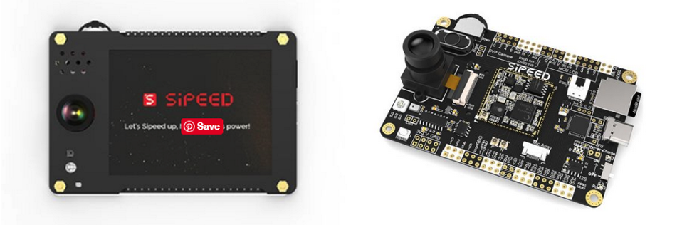
Overview - MAIX Go
The Go board is 88x60mm, all pins out, with standard M12 lens DVP camera, and the Camera can be flipped from front to rear.
The on board JTAG&UART based on STM32F103C8 enable developers debug M1 without extra J-link, the lithium battery manager chip enable the board be powered with lithium battery and USB without conflict.
I2S Mic, Speaker, RGB LED, Mic array connector, thumbwheel, TF card Slot are all included in the board.
Notes:
The Go board is 88x60mm, all pins out, with standard M12 lens DVP camera, and the Camera can be flipped from front to rear.
I2S Mic, Speaker, RGB LED, Mic array connector, thumbwheel, TF card Slot are all included in the board.

Slide 12
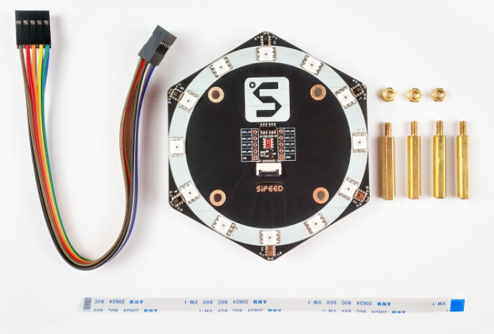
Overview - 6+1 Microphone Array
Sipeed 6+1 Microphone Array is a 6-microphone expansion board for MAIX AI development boards designed for AI and voice applications.
Including 6+1 digital microphones, 12 three-color LEDs, it supports sound localization, beam forming, speech recognition etc.
With 6+1 microphone array and MAIX development boards, application like AI speaker can be prototyped easier and faster.
Notes:
Sipeed 6+1 Microphone Array is a 6-microphone expansion board for MAIX AI development boards designed for AI and voice applications.
Including 6+1 digital microphones, 12 three-color LEDs, it supports sound localization, beam forming, speech recognition etc.
With 6+1 microphone array and MAIX development boards, application like AI speaker can be prototyped easier and faster.
Prototype of sound source tracking camera can also be built rapidly if add a Pan-Tilt camera.

Slide 13
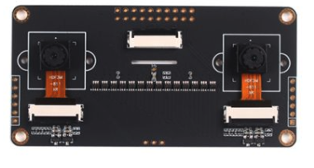
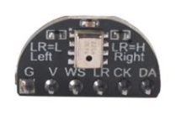
Overview - Binocular camera & I2S Mic module
Sipeed Binocular camera module is a camera expansion board for MAIX AI development boards designed for AI and Binocular stereo vision applications. It supports Binocular stereo vision and depth vision.
Sipeed I2S Mic Module is a mini size single MEMS microphone that can be connected to MAIX development boards Dock/Go/Bit as well as the Sipeed Binocular camera easily. it's high sensitivity, low Noise and cost-effective.
Notes:
Sipeed Binocular camera module is a camera expansion board for MAIX AI development boards designed for AI and Binocular stereo vision applications. It supports Binocular stereo vision and depth vision.
Sipeed I2S Mic Module is a mini size single MEMS microphone that can be connected to MAIX development boards Dock/Go/Bit as well as the Sipeed Binocular camera easily. it's high sensitivity, low Noise and cost-effective.

Slide 14
K210 & MAIX-I module Key Features
28nm process, dual-core RISC-V 64bit IMAFDC, on-chip huge 8MB high-speed SRAM (not for XMR), 400MHz frequency (able to 800MHz)
KPU (Neural Network Processor) inside, 64 KPU which is 576bit width, support convolution kernels, any form of activation function. It offers 0.25TOPS@0.3W, 400MHz, (0.5TOPS when 800MHz). Do object recognition 60fps@VGA
APU (Audio Processor) inside, support 8mics, up to 192KHz sample rate, hardcore FFT unit inside, easy to make a Mic Array
Flexible FPIOA (Field Programmable IO Array), available to map 255 functions to all 48 GPIOs on the chip
DVP camera and MCU LCD interface, connect DVP camera and display on LCD
Many other accelerators and peripherals: AES Accelerator, SHA256 Accelerator, FFT Accelerator (not APU's one), OTP, UART, WDT, IIC, SPI, I2S, TIMER, RTC, PWM, etc.
Notes:
In hardware, MAIX-I have powerful KPU K210 inside, it offers many excited features:
28nm process, dual-core RISC-V 64bit IMAFDC, on-chip huge 8MB high-speed, 400MHz frequency
KPU inside, support convolution kernels, any form of activation function. Offers 0.25TOPS@0.3W, 400MHz
APU inside, support 8mics, up to 192KHz sample rate
Flexible FPIOA, available to map 255 functions to all 48 GPIOs on the chip

Slide 15
M1w Dock & MAIX BiT Key Features
RISC-V Dual Core 64bit, 400MHz adjustable, open architecture-based processor with rich community resources
High-speed UART and JTAG interface for debugging
All GPIOs connected to header; Support Micro SD card holder
Onboard CH340(CH552 for new version), which support 2Mbps band rate
24P 0.5mm FPC connector for DVP Camera
8bit MCU LCD 24P 0.5mm FPC connector
RST button and USR button; Provide 3.3V and 1.8V to developers
Support FreeRTOS and Standard development kit; Support Micro Python on M1
Machine vision based on convolutional neural network
High performance microphone array processor
Notes:
Besides the features of K210 & MAIX-I module, M1w Dock & MAIX BiT have several other impressing features:
High-speed UART and JTAG interface for debugging
All GPIOs connected to header; Support Micro SD card holder
Onboard CH340, which support 2Mbps band rate
24P 0.5mm FPC connector for DVP Camera
8bit MCU LCD 24P 0.5mm FPC connector
RST button and USR button; Provide 3.3V and 1.8V to developers

Slide 16
MAIX Go Key Features
CPU: RISC-V Dual Core 64bit, with FPU, 400MHz standard Frequency (Can be overclocked to 800MHz); QVGA@60FPS/VGA@30FPS image identification
Onboard omnidirectional, bottom-ported, I2S digital output MEMS Microphone MSM261S4030H0; Support Sipeed R6+1 Microphone Array board with FPC10 connector and 2x3W Speaker
On board digital triaxial accelerometer MSA300, user selectable range: ±2/4/6/8g; On board 32.768k crystal connected with STM32F103; MAIX-LCD board (with Resistive touch screen) is directly connected to the pin header
Support 2.4G 802.11. b/g/n; Support Self-elastic card holder; Three-way dial switch and one Reset push button; All GPIOs connected to header 2*20 2.54mm; Just connect the USB Type-C cable to complete the download; Charging current up to 2.5A; integrated dynamic path management;
Support FreeRTOS and Standard development kit; Support Micro Python on M1; Machine vision based on convolutional neural network
Notes:
Besides the features of K210 & MAIX-I module, MAIX Go have below impressing features:
Onboard omnidirectional, bottom-ported, I2S digital output MEMS Microphone; Support Sipeed R6+1 Microphone Array board with FPC10 connector and 2x3W Speaker
On board digital triaxial accelerometer MSA300; On board 32.768k crystal connected with STM32F103;
Support 2.4G 802.11. b/g/n; Support Self-elastic card holder; Three-way dial switch and one Reset push button;
All GPIOs connected to header 2*20 2.54mm; Just connect the USB Type-C cable to complete the download

Slide 17
MAIX Software Key Features
MAIX support original standalone SDK, FreeRTOS SDK base on C/C++
MAIX support MicroPython(MaixPy IDE), MaixPy ported MicroPython to K210. A project that supports MCU routine operations and integrates machine vision and microphone arrays to quickly develop intelligent applications in the AIOT field that are extremely cost effective and practical.
MAIX support OpenMV IDE, Arduino IDE, PlatformIO IDE
MAIX support fixed-point model that the mainstream training framework trains, according to specific restriction rules, and have model compiler to compile models to its own model format.
MAIX support tiny-yolo, mobilenet-v1, and, TensorFlow Lite. Many TensorFlow Lite model can be compiled and run on MAIX.
Notes:
Sipeed MAIX has wide compatibility and support on soft development tool and ecosystem.
Except the standalone SDK, FreeRTOS SDK base on C/C++, MAIX support MicroPython, OpenMV IDE, Arduino IDE and PlatformIO IDE.
For DeepLearning, MAIX support Tiny-Yolo, Mobilenet and TensorFlow Lite.

Slide 18
Getting Started - PREPARE - Required Hardware
Sipeed MAIX Dev. Board(M1 Dock/Bit/Go)
USB Type C cable; Camera(default: ov2640 )
LCD Screen (default: 24pin interface, st7789 driver chip, 320x240)
Micro SD Card/TF Card (Optional, facilitate the quick operation of the pictures)
ST-Link (Optional, for updating the firmware of the STM32 on MAIX Go)
JTAG Debugger (optional, if need debugging)
Notes:
To start learning/developing with Sipeed MAIX, development board and peripherals are needed:
Choose dock, bit or Go based on needs, USB Type C Cable, OV2640 Camera, LCD Screen are essential, Micro SD Card Card, ST-Link and JTAG Debugger are optional.

Slide 19
Getting Started - PREPARE - Update Firmware
PREPARE – Update Firmware
1. Connect the Dev. Board to computer with USB Type C cable
2. Install the serial port driver
For Dock or MAIX Bit( on board CH340)
No need to install driver for Linux. For Windows, use ls /dev/ttyUSB* to see the device number, download the driver from internet and install it, then the serial device will be shown in the Device Manager
2) For MAIX Go
https://maixpy.sipeed.com/en/get_started/upgrade_firmware.html#for-maix-go
3. Get the upgrade tool
1)Ubuntu(Linux)
Download tool: kflash.py
Operate the serial port under Linux or Mac. If you don't want to use the sudo command every time, execute sudo usermod -a -G dialout $(whoami) to add yourself to the dialout user group. May need to be logged off or restarted to take effect
Notes:
Firmware may need an update before formal use.
Connect the Dev. Board to computer with USB Type C cable, install the serial port driver, get the upgrade tool

Slide 20
Getting Started - PREPARE - Update Firmware
sudo apt update
sudo apt install git python3 python3-pip
sudo pip3 install pyserial
git clone https://github.com/sipeed/kflash.py
2)Windows
K-Flash: Download from github
Or download from the official kendryte page
If it is the Maix Go development board, currently only the kflash.py script can be used for burning, so you need to install python3 on your computer. Then download kflash.py
- Or Use Cross platform GUI wrapper
https://github.com/sipeed/kflash_gui
4. Get the Firmware
Download from github page, Firmware endup with .bin or .kfpkg
5. Download the firmware to the dev. Board
Use the following command to burn, you can use python3 kflash.py --help to get help.
sudo python3 kflash.py -p /dev/ttyUSB0 -b 2000000 -B dan firmware.bin
-p is the specified device, use ls /dev/ttyUSB* to view the device
-b is specified baud rate, if the download fails, pls try again after reduce the baud rate
-B is specified board, no need to worry if no support model, you can still download, but may need to reset before boot. Maix Go uses -B goD or -B goE.
Notes:
Then get the firmware and download it to development board.

Slide 21
Getting Started
Power up the device, first time setup with MaixPy
https://maixpy.sipeed.com/en/get_started/power_on.html
Lighting the LED
https://maixpy.sipeed.com/en/get_started/led_blink.html
Edit and execute the file
https://maixpy.sipeed.com/en/get_started/edit_file.html
MaixPy has a built-in file system
Why do I need to edit and execute the file?
Edit and save the file
Execution documents
Upload script to development board
https://maixpy.sipeed.com/en/get_started/upload_script.html or using MaixPy IDE
Uploading and running scripts using the graphical tool uPyLoader
Using Tool rshell
Using the command line tool ampy
TF card copy
Boot from startup script
Notes:
Follow the instructions in the attached links to setup Maixpy for the first time: power up the devices, lighting the LED, edit and execute the file, etc.

Slide 22
Resources
SDK: dl.sipeed.com/MAIX/SDK
HDK: dl.sipeed.com/MAIX/HDK
MaixPy: dl.sipeed.com/MAIX/MaixPy
IDE: http://dl.sipeed.com/MAIX/MaixPy/release/maixpy_v0.3.1/
GitHub - MaixPy: https://github.com/sipeed/MaixPy/releases
Wiki: maixpy.sipeed.com
Blog: blog.sipeed.com
BBS: bbs.sipeed.com
Support: support@sipeed.com
Telegram group: https://t.me/sipeed
Powerful Maix Board(k210) Can Do
https://maixpy.sipeed.com/en/others/what_maix_do.html
Kendryte Standalone SDK Programming Guide-EN-V0.3.0
Kendryte FreeRTOS SDK Programming Guide-EN-V0.1.0
Notes:
Abundant software and hardware resources can be download through the attached links.
Communicate with Sipeed Engineers as well as fans or developers directly through Telegram group or BBS. Get relative info. updates from Sipeed Blog.

Slide 23

Applications
Smart Home applications like robot cleaners, smart speakers, electronic door locks, household monitoring etc.
Medical Industry applications like Auxiliary diagnosis and treatment, medical image recognition, emergency alarm etc.
Smart Industry applications like industrial machinery, intelligent sorting, monitoring of electrical equipment, etc.
Education applications like educational robots, intelligent interactive platforms, educational efficiency inspection, etc.
Agriculture applications like agricultural monitoring, pest and disease monitoring, automated control, etc.
Notes:
MAIX can be used for a growing number of industrial use-cases such as predictive maintenance, anomaly detection, machine vision, robotics, voice recognition, and many more. It can be used in manufacturing, on-premise, healthcare, retail, smart spaces, transportation, etc.

Slide 24
Advantages
RISC-V 64 AI module, dev boards and substantial sensor module makes AI much easier. Flexible layout of board, easy to go. Active community, update the docs regularly
MAIX isn't just a hardware solution, it combines custom hardware, open software, and state-of-the-art AI algorithms
Thanks to its performance, small footprint, low power, and low cost, MAIX enables the broad deployment of high-quality AI at the edge.
MaixPy is an open source MicroPython project based on the Sipeed M1 platform. With only 12 lines of code, you can run a face recognition demo. It's scalable, long term maintained.
Notes:
There are many advantages to develop with the Sipeed MAIX
RISC-V 64 AI module, dev boards and substantial sensor module makes AI much easier.
Flexible layout of board, easy to go.
Active community, update the docs regularly
MAIX isn't just a hardware solution, it combines custom hardware, open software, and state-of-the-art AI algorithms
And thanks to its performance, small footprint, low power, and low cost, MAIX enables the broad deployment of high-quality AI at the edge.
Meanwhile, MaixPy is an open source MicroPython project based on the Sipeed M1 platform. With only 12 lines of code, you can run a face recognition demo. It's scalable, long term maintained.

Slide 25
Summary
Overall hardware ecology
More than hardware solution
Enable broad deployment of high-quality Edge AI
Enable rapid and agile prototype development
Notes:
Sipeed MAIX provides more than hardware solution, but an overall hardware ecology.
Sipeed MAIX enable rapid and agile prototype development and broad deployment of high-quality Edge AI.

